Slide 1



ShipIt Day Team Tablo

Slide 2
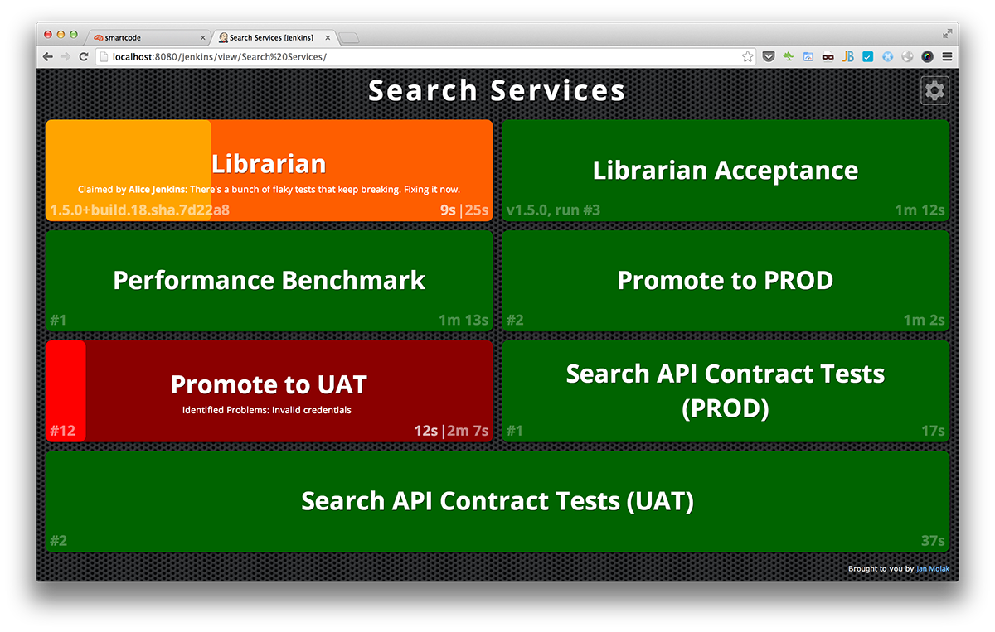
CI Dashboards
They help us monitor things!

Slide 3

CI Dashboards
They help us monitor things!
Prevent/Detect incidents from happening

Slide 4
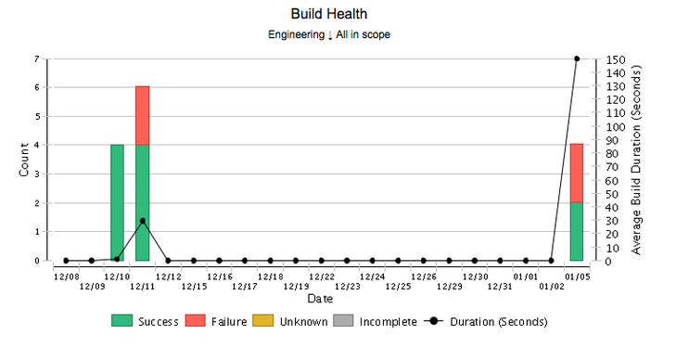
CI Dashboards
They help us monitor things!
Prevent/Detect incidents from happening
Provide evidence/benchmark for stability

Slide 5

CI Dashboards
They help us monitor things!
Prevent/Detect incidents from happening
Provide evidence/benchmark for stability
Only useful if people look at it!

Slide 6
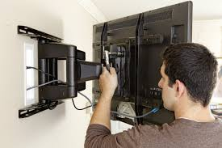
CI Dashboards
They help us monitor things!
Prevent/Detect incidents from happening
Provide evidence/benchmark for stability
Only useful if people look at it!
Moving the hardware could be a real hassle!

Slide 7


CI Dashboards
The Tablo approach

Slide 8
{Diagram photo of Tablo} - can be used for any CI system that implements a RESTful API. -
CI Dashboards
The Tablo approach

